Slide 1
We Suck
Code for Good: Team 4

Slide 2
Inspiration
“Education is a cornerstone of our organization”
Develop a game that uses education to drive user retention

Slide 3
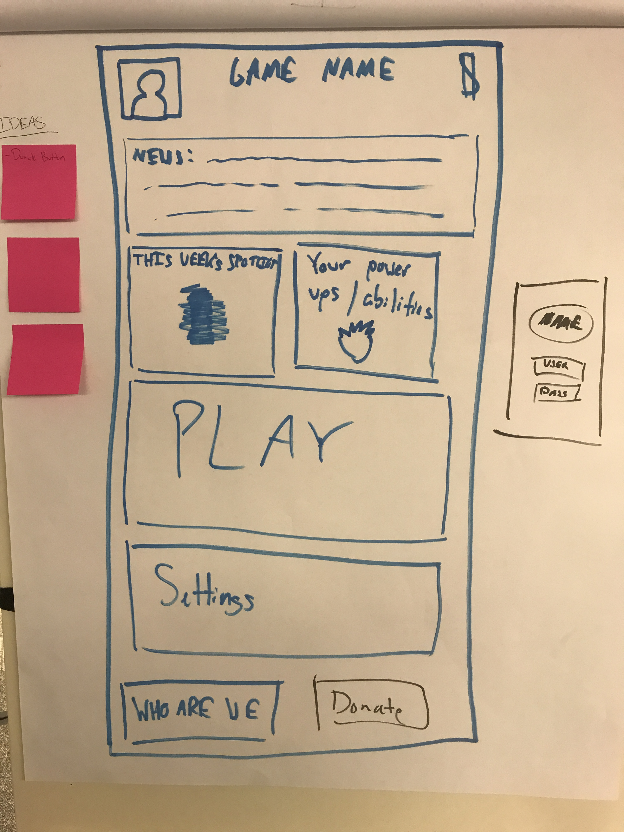
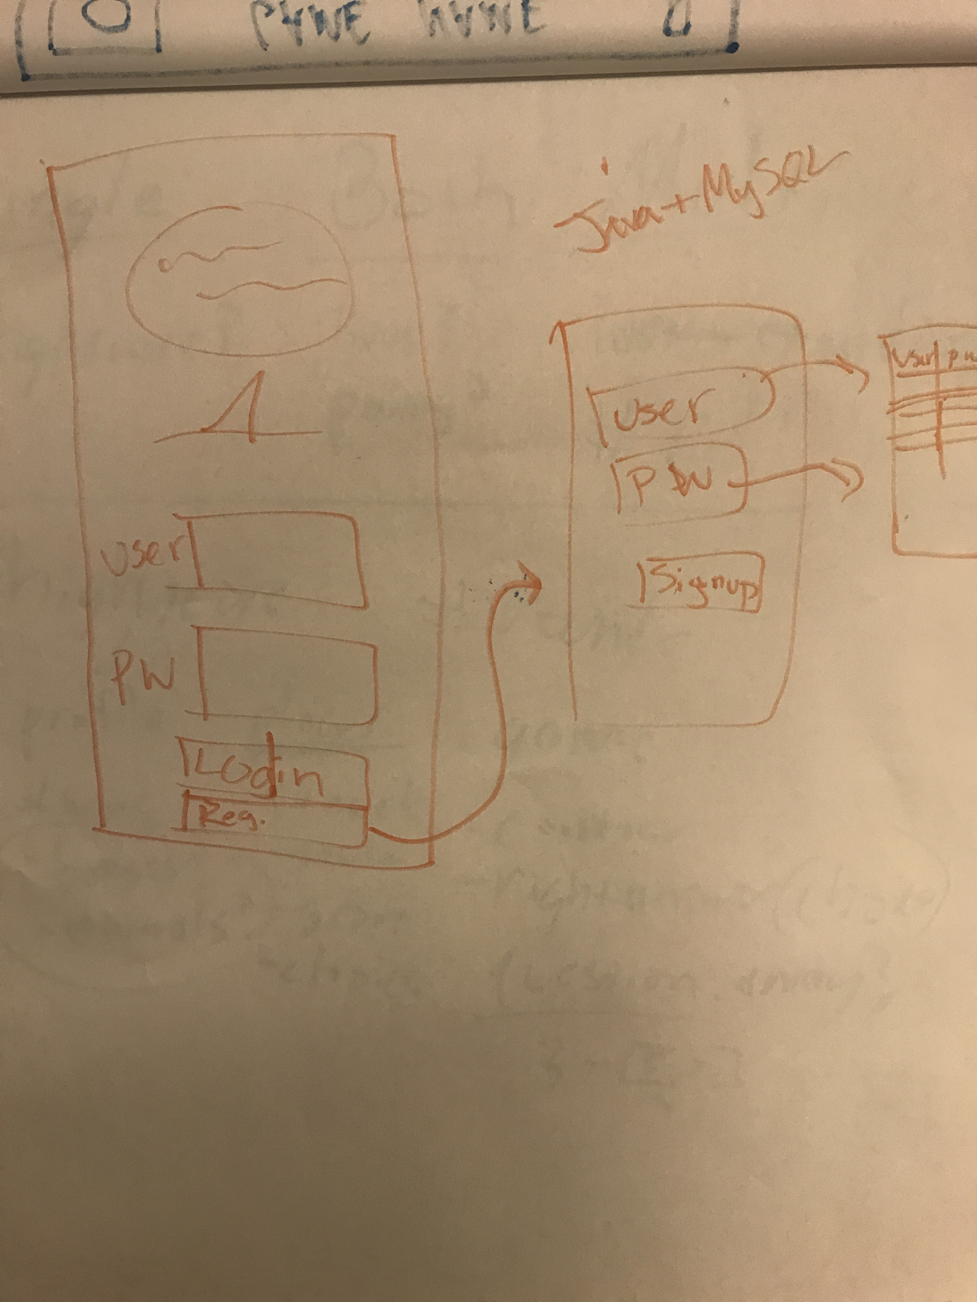
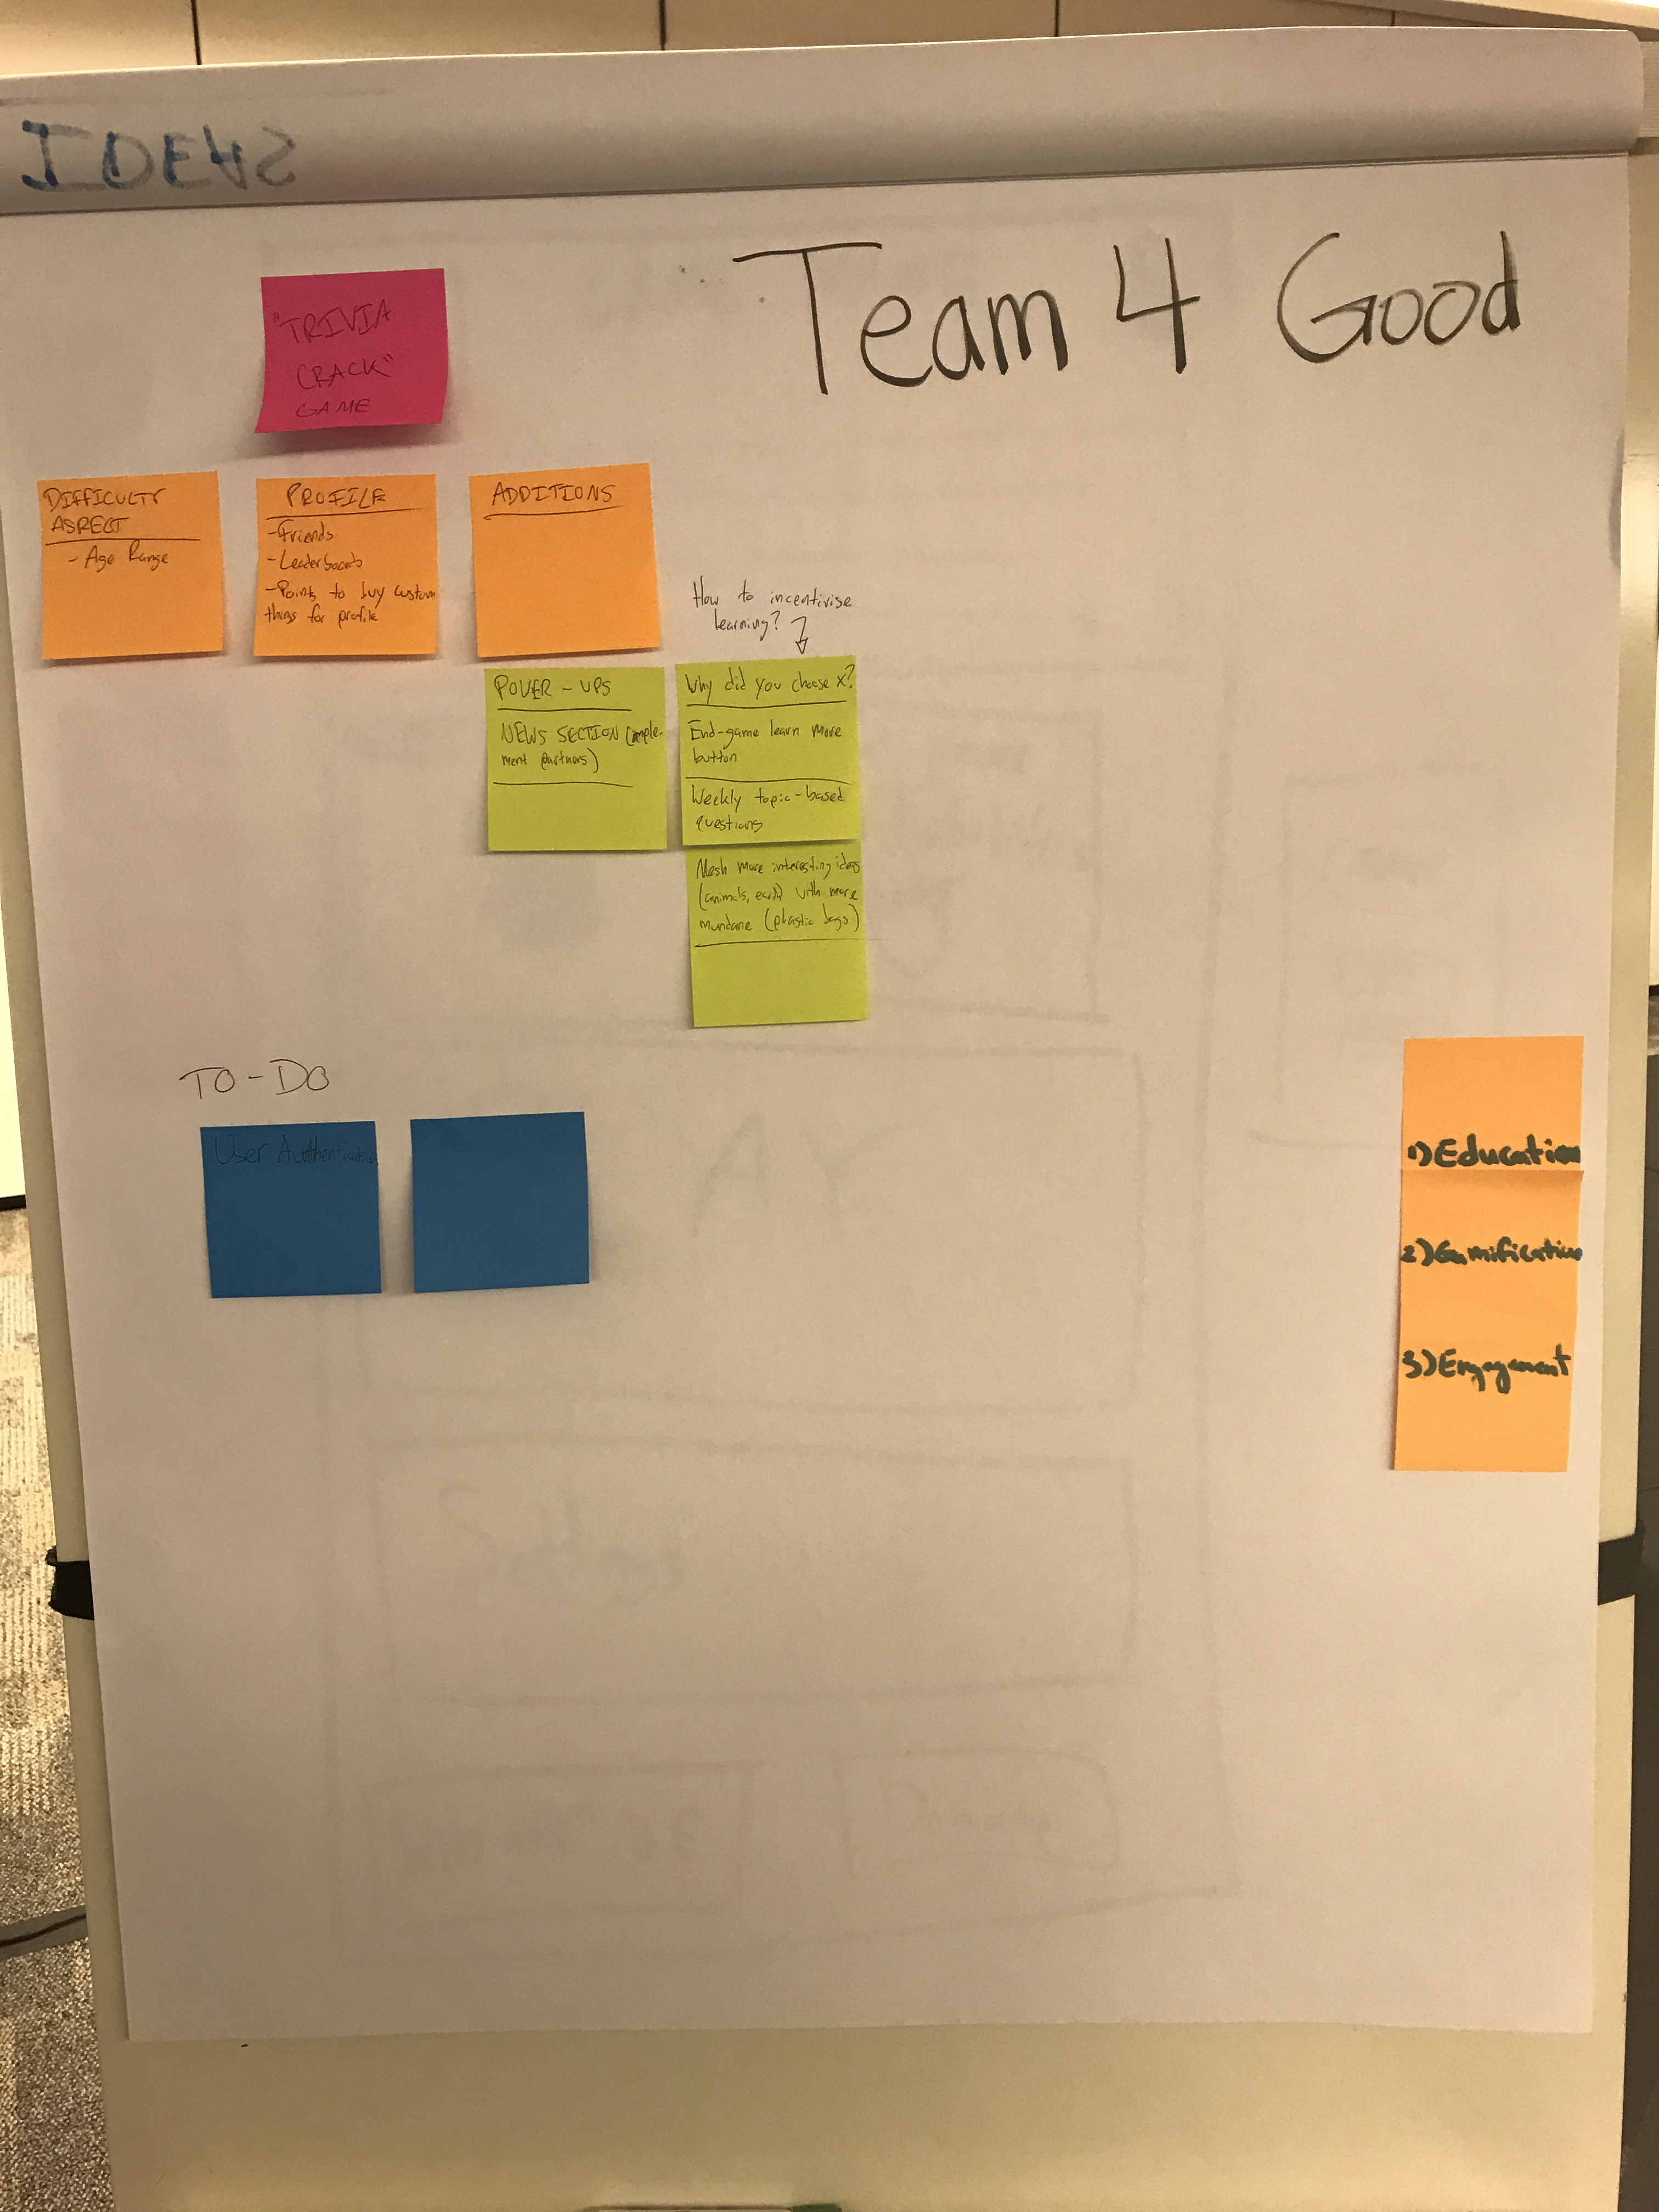
Background
Target age range
Which type of game(s) have good replay value?
How to incorporate ODCA’s mission into every page

Slide 4
Demo

Slide 5
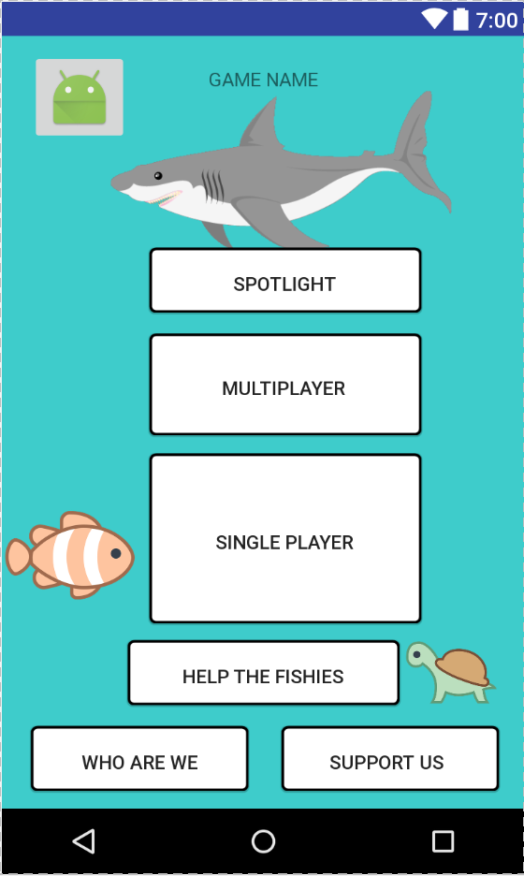
Key Features
Spotlight
Multiplayer vs. Single Player

Slide 6
What We Wish We Did
Added database functionality for login authentication using Firebase or MySQL/PHP
Properly implemented a profile with a badge system
Categories for quizzes
Online multiplayer using multithreading

